Slide 1

Rrrrr – Software for Pirates by Ralf Martin (r.martin@imperial.ac.uk)

Slide 2

Why R?
Pros
The Pirates’ choice of software
It’s free (like pirates)
Open source, many contributors
Many contributed modules and extensions
Many different ways to do the same thing
Easy integration with other software
A new industry standard used across many fields
Increasingly used in business and media
Flexible
You can program stuff
Cons:
Open source, many contributors
Many different ways to do the same thing

Slide 3
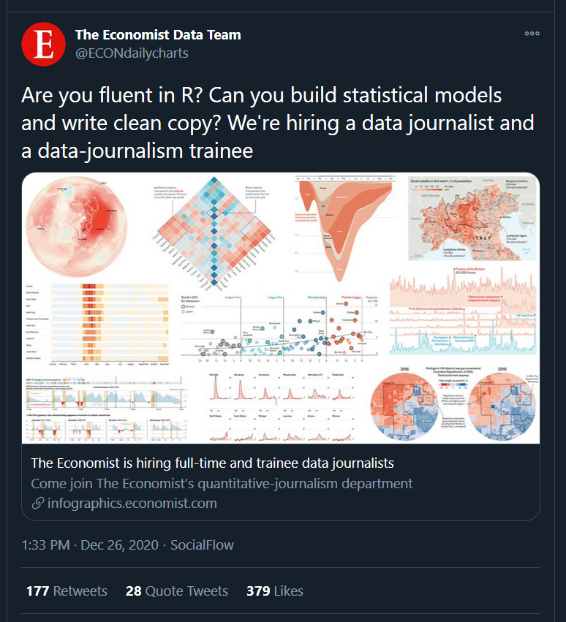
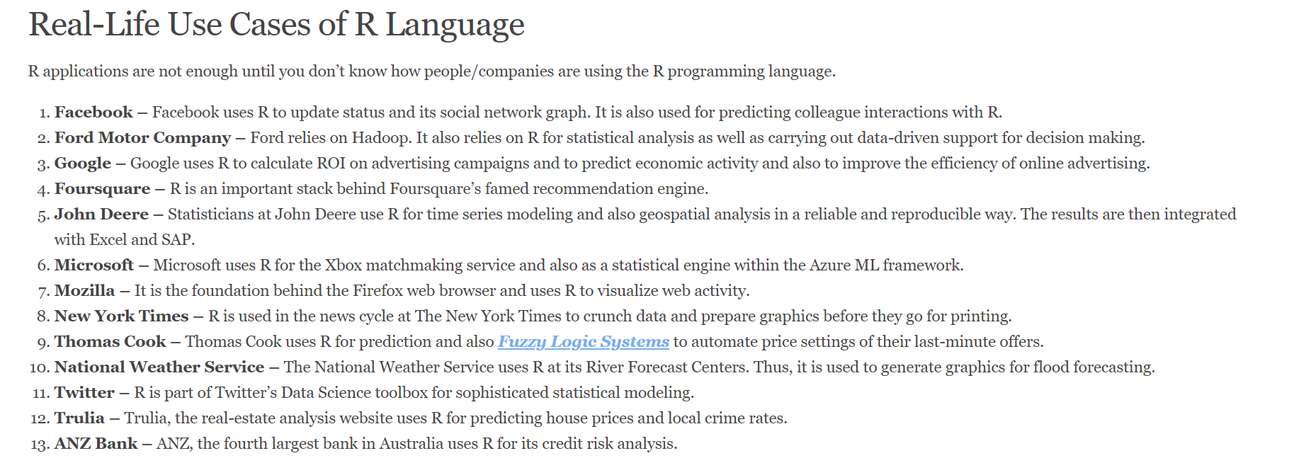
R Matters

Slide 4

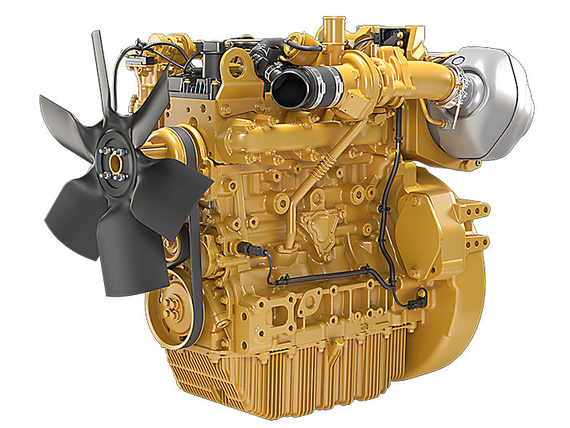

R vs RStudio
Rstudio is a nice control software to run your R engine
A Pirate (You)

Slide 5
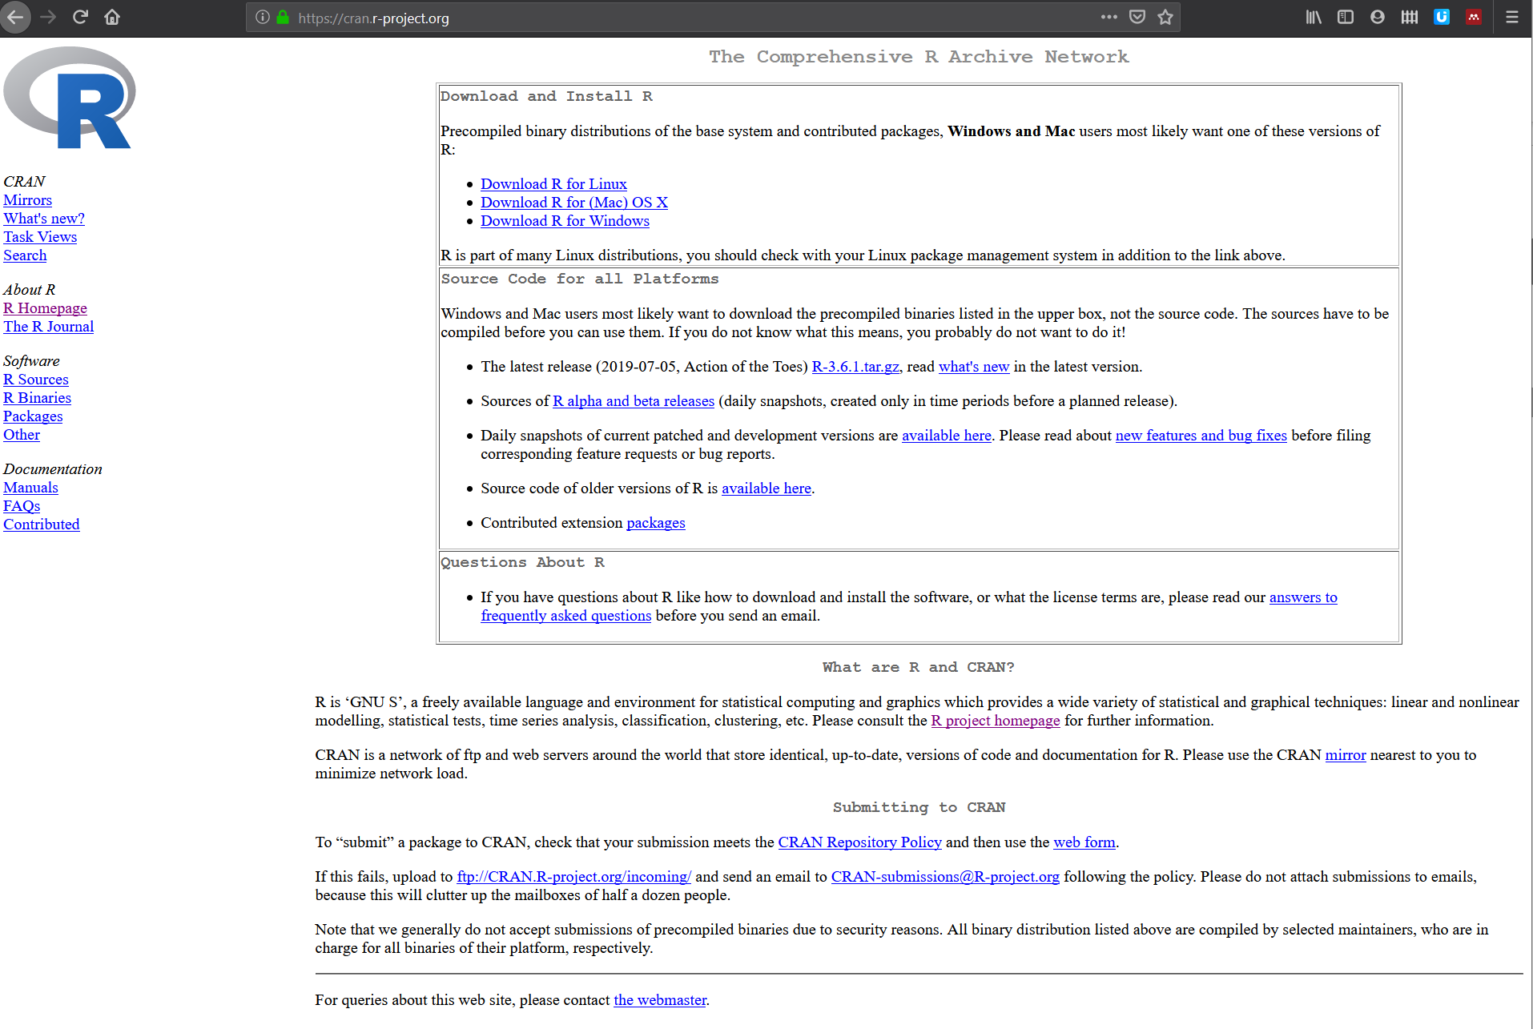
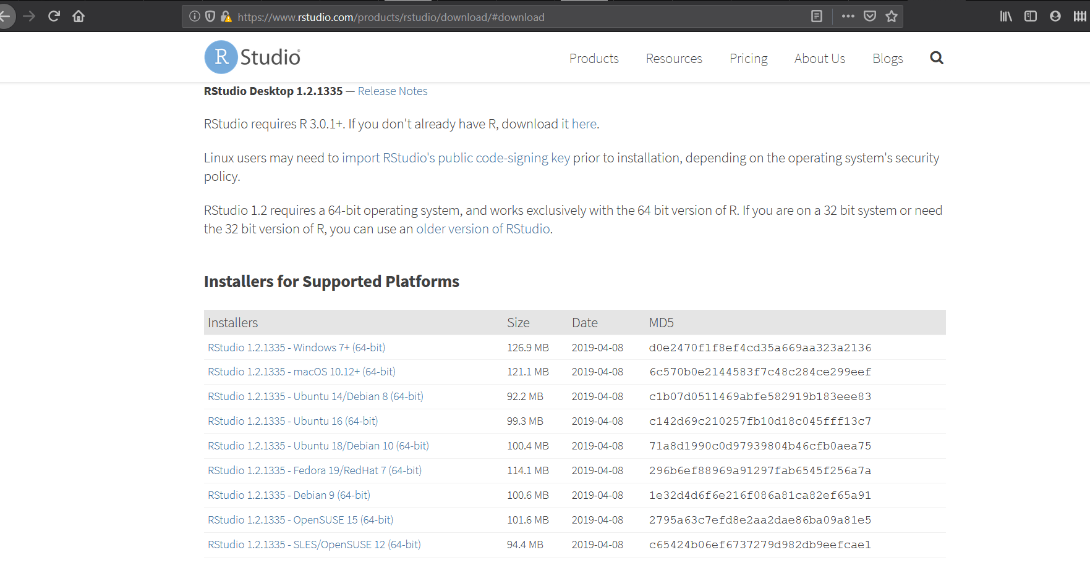
Getting started
Download R (and install)
https://www.r-project.org/
Download Rstudio
https://www.rstudio.com/

Slide 6
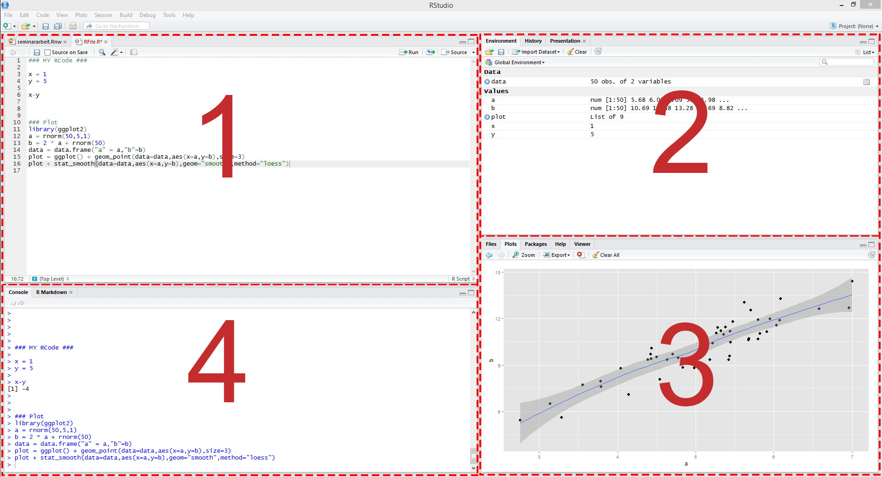
The R studio setup
1= code file
2= variable browser
3= plot browser
4= command console

Slide 7

You can use R as a pocket calculator
How to talk to R?
Write commands in the console to be executed immediately
Write commands in a script file to executed later or repeatedly
7/6
## [1] 1.166667
Create lists
1:10
runif(10)
seq(0,20,2)
sample(1:6,5)

Slide 8

The secret of learning to code:
pLaY
steal some toys
and play some more
by that I mean code
Good places to steal code (just google):
stackexchange
Stackoverflow
github
(you are pirates after all)
Try to understand code of others
Make small changes
See what happens
Adapt code by others for your purposes
Read about the commands we are using as well as related commands

Slide 9
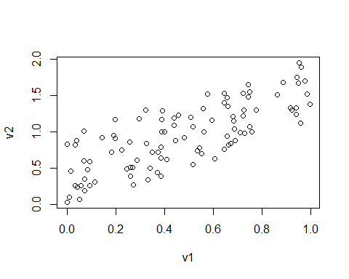
Create new variables based on already existing one
You can Assign Variables
v1=runif(100)
v2=runif(100)+v1
Do stuff with variables; e.g. plotting them
plot(v1,v2)

Slide 10
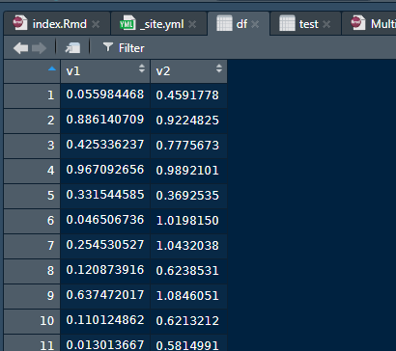
Dataframe
To organise data we can put vectors of data into a dataframe; i.e. table
You can look at it like in an excel table:
Most of the time a dataset you get from somewhere will be arranged in a dataframe; e.g. the data on foreigners and crime you can load via
df=data.frame(v1,v2)
df=read.csv("https://www.dropbox.com/s/g1w75gkw7g91zef/foreigners.csv?dl=1")

Slide 11
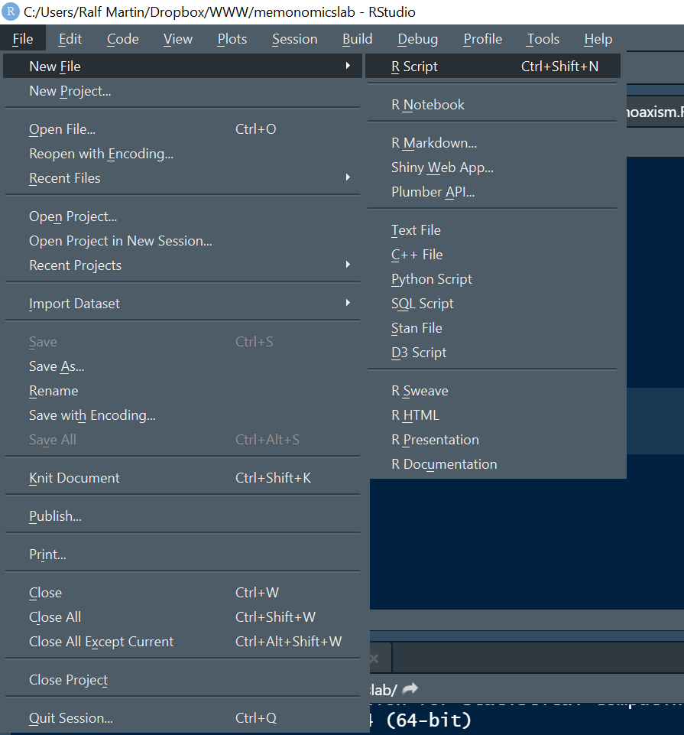
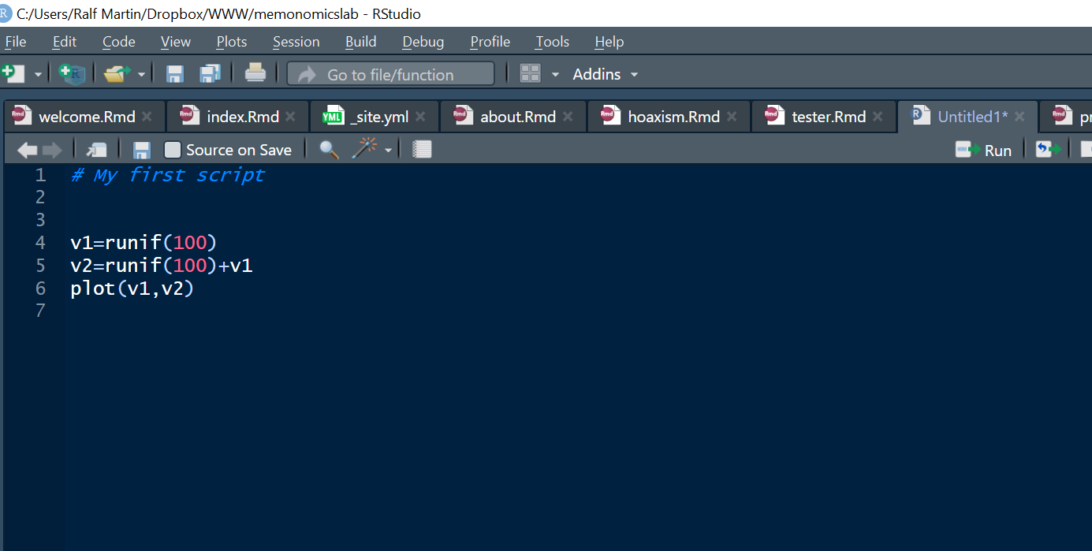
To organise research we can combine commands in script file
Documenting what was done (to yourself and others)
Identifying and correcting errors
Efficiently executing repeated tasks
Replication & reproduction of research

Slide 12
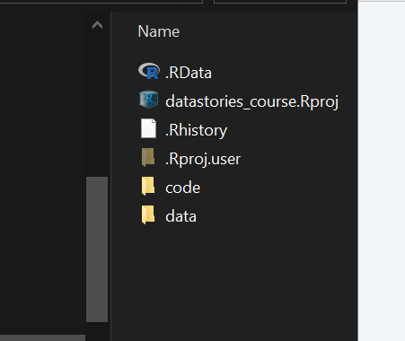
Folder structure
It’s a good idea to separate code and data
You have to mindful about the active directory
Also it’s good to use relative paths.
Play a little with the following code to work out how:
getwd()
## [1] "C:/Users/Ralf Martin/Dropbox/datastories/datastorieshub"
df=read.csv("./data/foreigners.csv") setwd("./data") getwd()
## [1] "C:/Users/Ralf Martin/Dropbox/datastories/data"
df=read.csv("foreigners.csv")

Slide 13
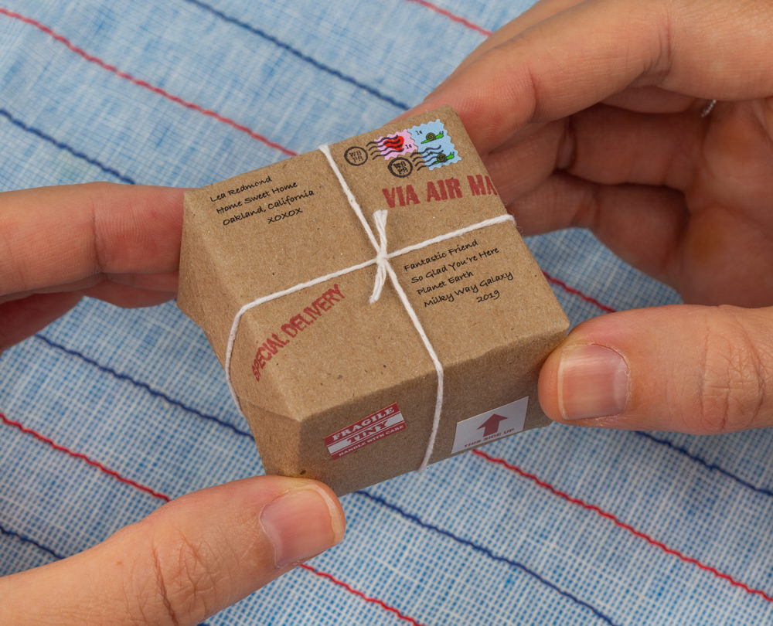
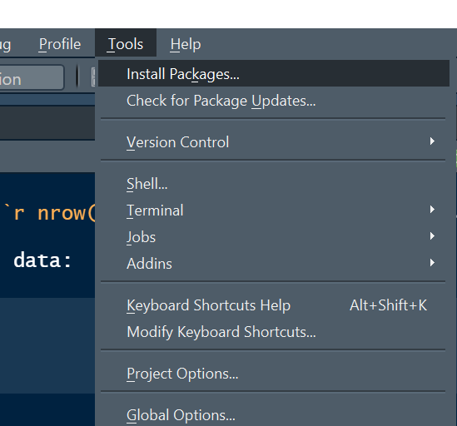
Packages
The power of R is in extensions that are created by many different contributors (will you become one?)
Before you can use a package you need to install it and load it.
Installing you only need to do once per computer
Loading is necessary each time you want to use for a given R session.
Note that sometimes different packages use the same name for a command that does not necessarily behave in the same way.
To install packages you can use
To load packages after install you can use the library() command.
Some packages we definitely need include: ggplot2, dplyr, haven
To check which packages you have loaded use (.packages())

Slide 14
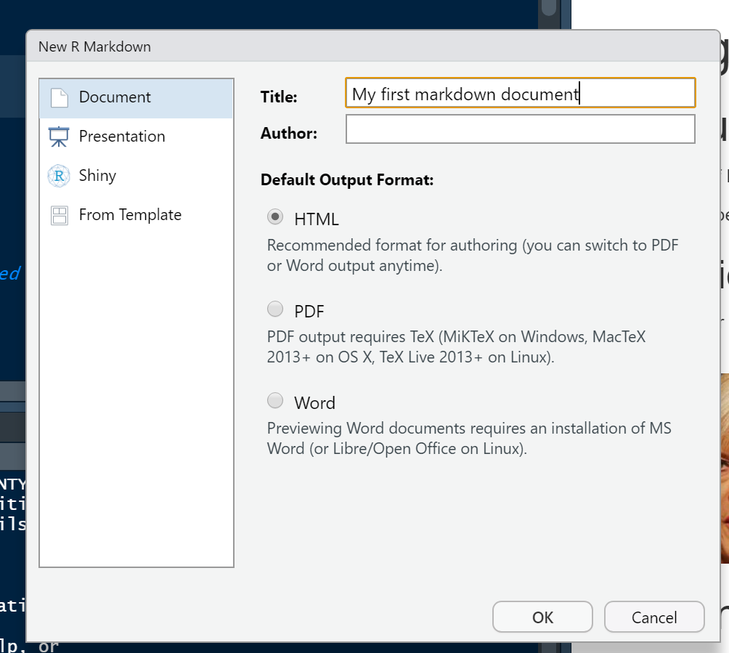
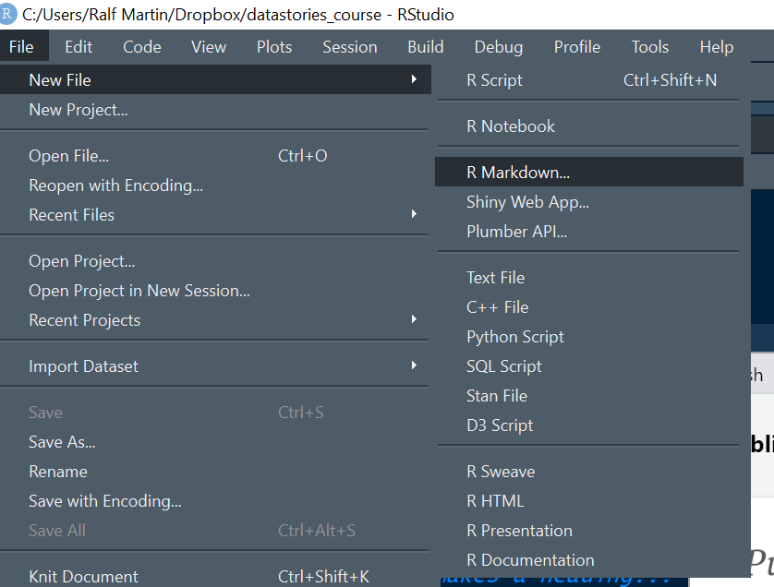
R Markdown
There is another type of script file called an R Markdown file with .Rmd file extension
This is like a normal script file but more powerful, because we can blend R code with R results and other content.
This can be used to create e.g. dashboards, pdfs, word documents or webpages.
Let’s create our first R webpage to workout how.
Save this in your code folder and/or download an Rmd document (FarageGarage.Rmd) I have already created here
A somewhat simpler file focusing on the key commands you need to get going is here.
Let’s start playing with this code

Slide 15
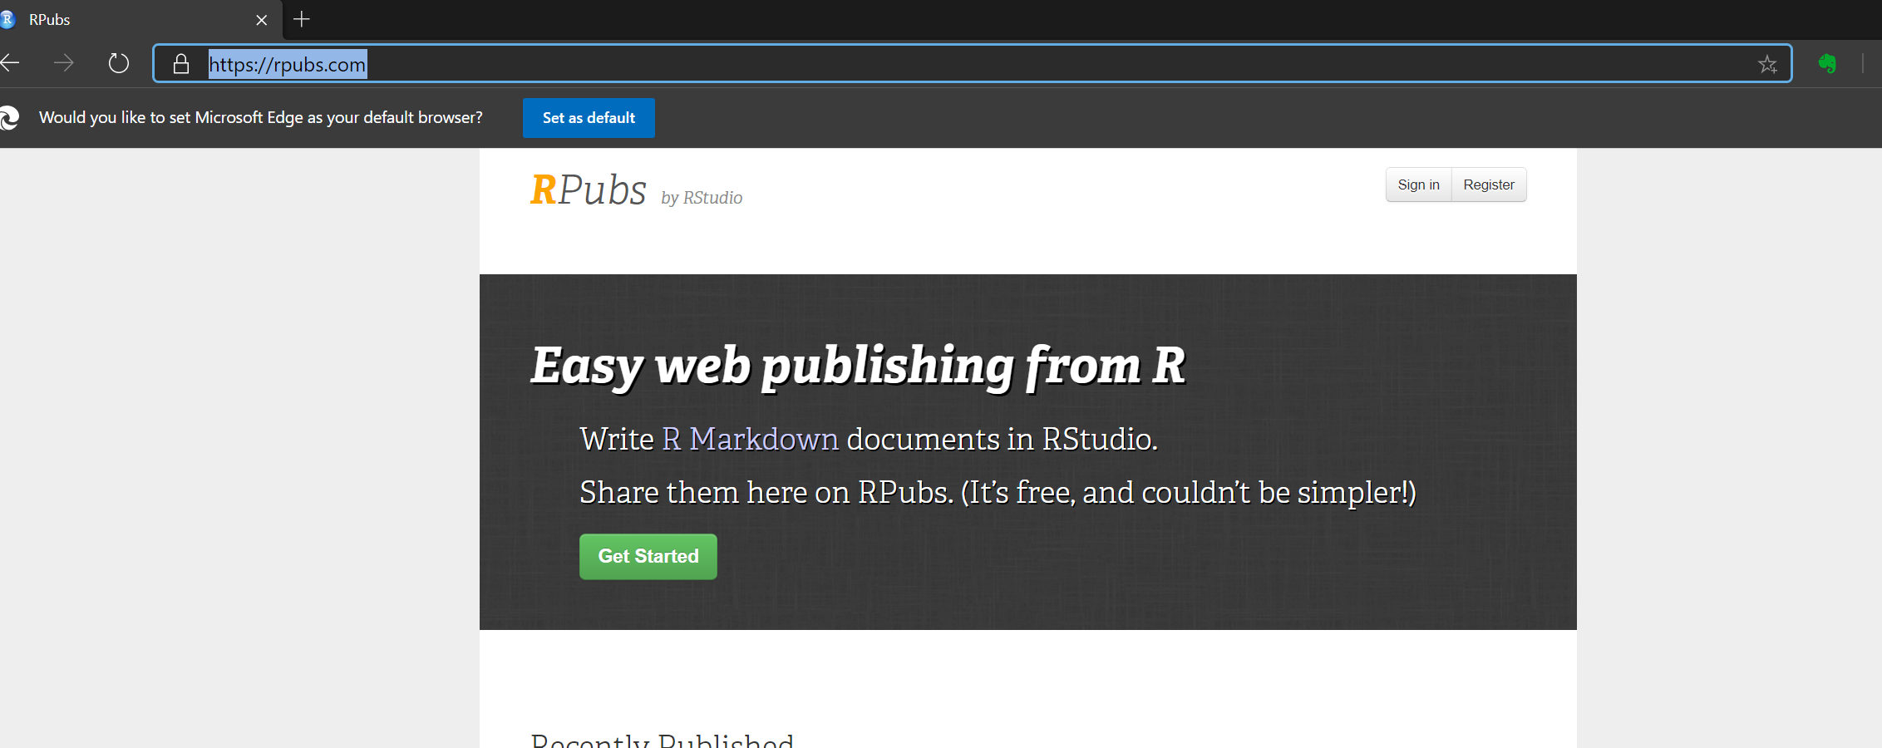
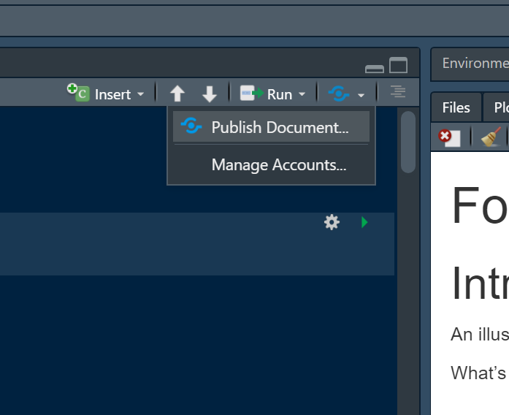
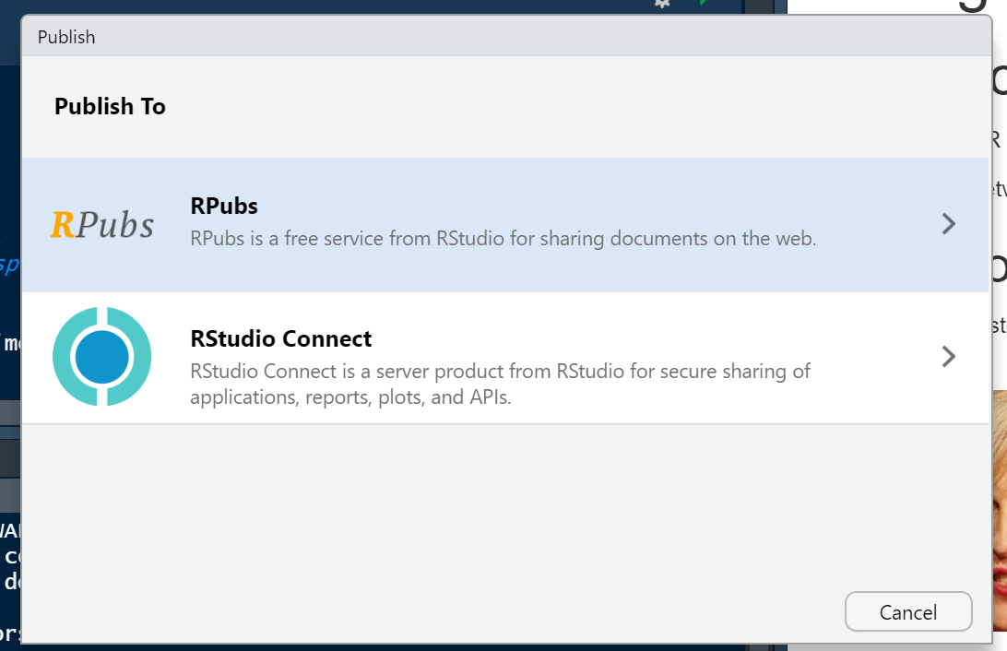
To publish online
Sign up for account on Rpubs:
Once you have an account you can publish an html document via the publish button

Slide 16
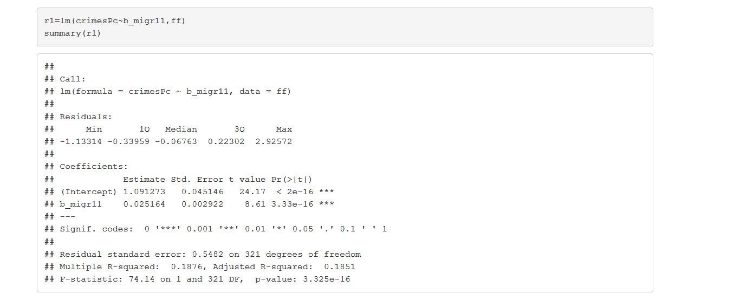


Fitting a line = Rrrrunning Rrrregressions
We said that putting in a trend line in a scatter plot is a way of estimating an
econometric model that describes the relationship between the dependent (or outcome) variable on the Y axis and an explanatory variable on the X axis.
If you want a computer to do this for you (rather take out a ruler and a pen) you need a precise algorithm.
The most commonly used algorithm for that is called Ordinary Least Squares estimator (OLS).
$$β_{0}$$
$$β_{1}$$

Slide 17
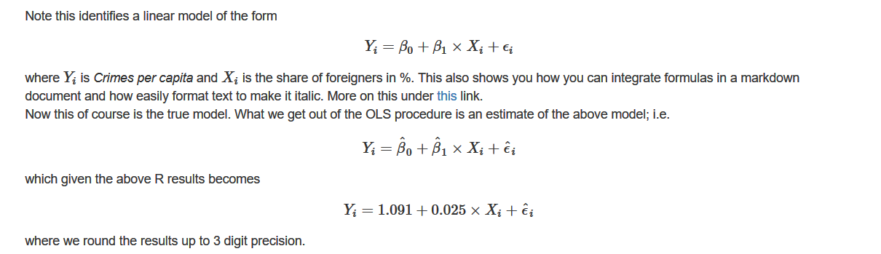
Ordinary Least Squares Regression (OLS)
Interpreting estimation results → Always depends on the units of X & Y
Here: A one percentage point increase in the share of foreigners leads to 0.025 more crimes per capita in a given year
Note: This is not necessarily a statement of fact as it depends on the precision of the estimate and the possibility of bias. Rather: it is the implication of our estimate if we took it at face value.

Slide 18

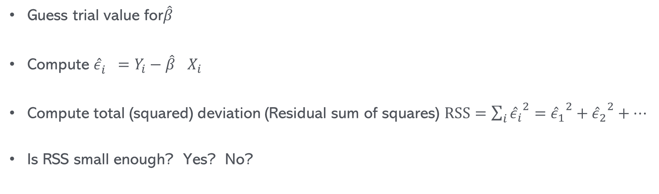
Kind of what the computer does:
$$Y_{i}=βX_{i}+ε_{i}$$
Try again
Guess trial value for$\hat{β}$
Compute ${\hat{ε}}_{i}^{}=Y_{i}−{\hat{β}}^{}X_{i}$
Compute total (squared) deviation (Residual sum of squares) $RSS=\sum_{i}{{{\hat{ε}}_{i}}^{2}}={{\hat{ε}}_{1}}^{2}+{{\hat{ε}}_{2}}^{2}+…$
Is RSS small enough? Yes? No?
Done

Slide 19
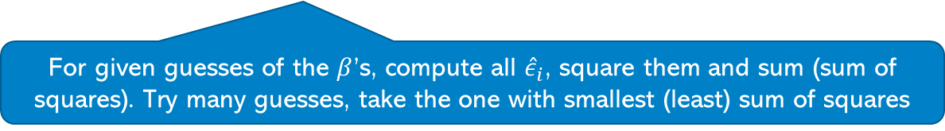
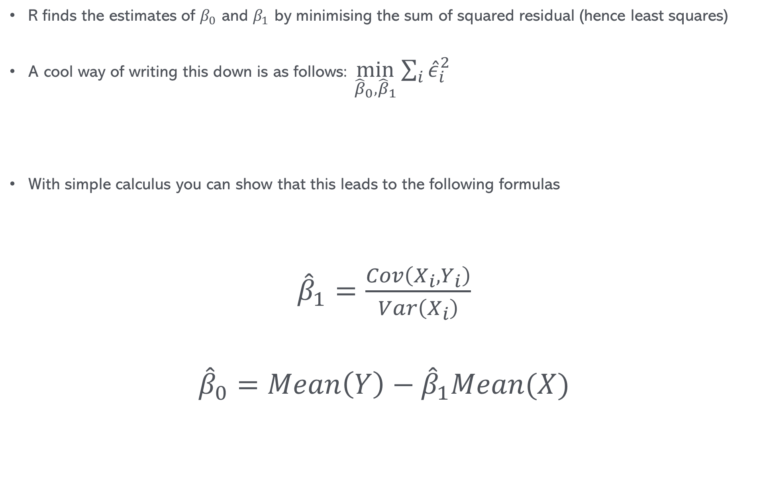
How does the OLS algorithm work?
R finds the estimates of $β_{0}$ and $β_{1}$ by minimising the sum of squared residual (hence least squares)
A cool way of writing this down is as follows: $\min_{{\hat{β}}_{0},{\hat{β}}_{1}}{\sum_{i}{{\hat{ε}}_{i}^{2}} }$
With simple calculus you can show that this leads to the following formulas
${\hat{β}}_{1}=\frac{Cov\left(X_{i},Y_{i}\right)}{Var\left(X_{i}\right)}$
$${\hat{β}}_{0}=Mean\left(Y\right)−{\hat{β}}_{1}Mean(X)$$
For given guesses of the $β$’s, compute all ${\hat{ε}}_{i}$, square them and sum (sum of squares). Try many guesses, take the one with smallest (least) sum of squares
It’s a good exercise to try to do this if you are used to calculus and algebra but I don’t expect this from you in any assessment

Slide 20
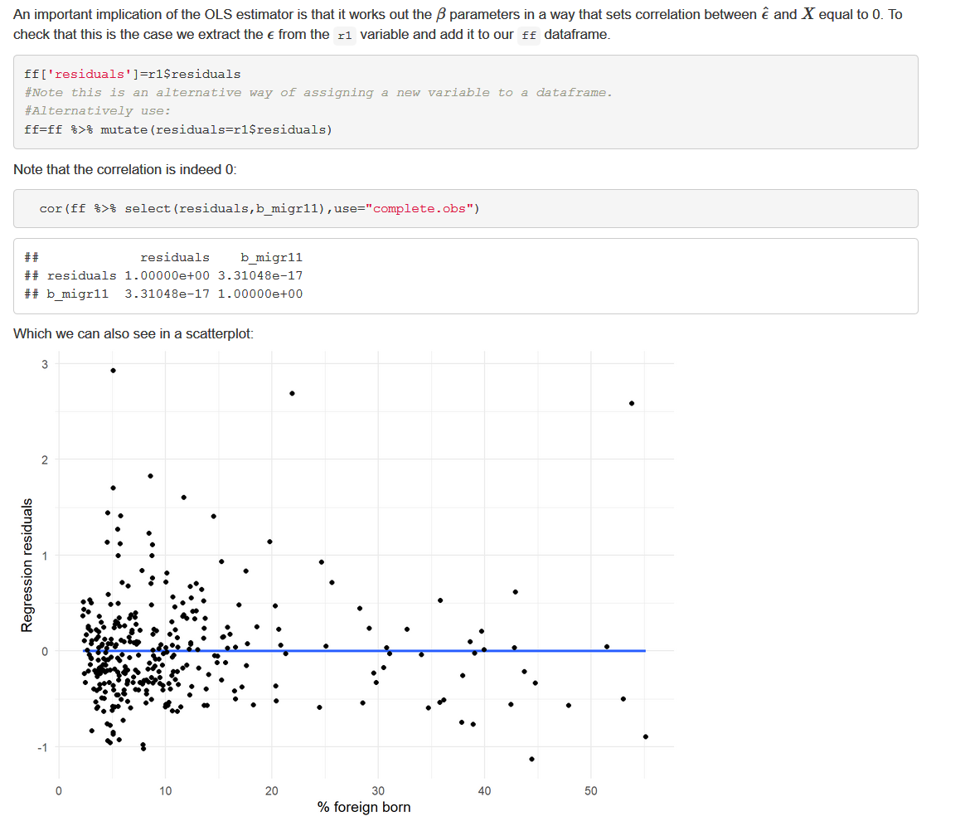
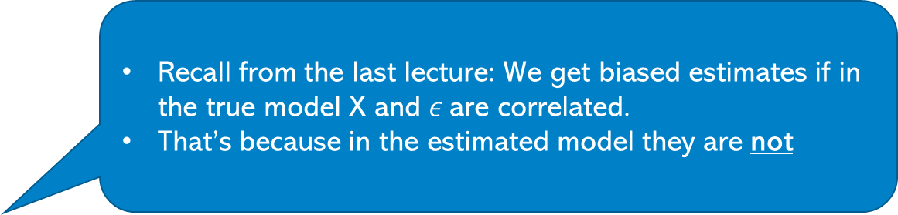
An important implication of the OLS algorithm
That is virtually 0
Recall from the last lecture: We get biased estimates if in the true model X and $ε$are correlated.
That’s because in the estimated model they are not

Slide 21

Takeaways
R is a powerful piece of software that allows you to do statistical and econometric computation and visualisation and many other things
Set up a dedicated directory and project file
Get used to working with script files (preferably R Markdown files)
Make sure to understand the LM command and OLS
Make sure to understand merging of data
Play with code:
If you see code that does something you like doing (e.g. from me) make sure you understand what different commands do
If you don’t understand a command google it (or use the help function) to understand it
See also the glossary of r commands (will continuously expand)

Slide 22

Extra Slides

Slide 23
Merging/Joining data
Full join
ID | Variable1 | Variable 2
A | 4 | NA
B | 21 | 6
C | 3 | 5
D | NA | 4
ID | Variable 1
A | 4
B | 21
C | 3
ID | Variable 2
B | 6
C | 5
D | 4
Inner join
ID | Variable1 | Variable 2
B | 21 | 6
C | 3 | 5
Left join
Right join
ID | Variable1 | Variable 2
A | 4 | NA
B | 21 | 6
C | 3 | 5
ID | Variable1 | Variable 2
B | 21 | 6
C | 3 | 5
D | NA | 4

Slide 24
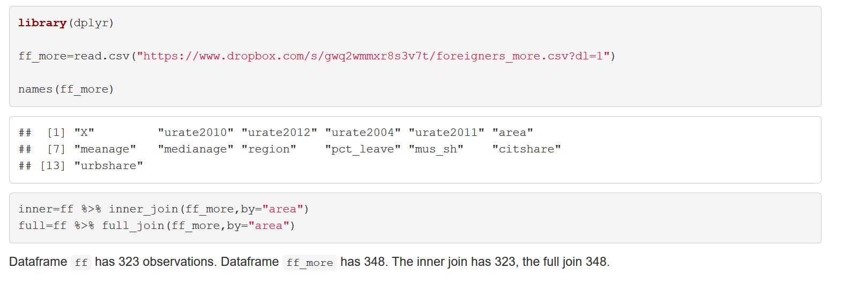
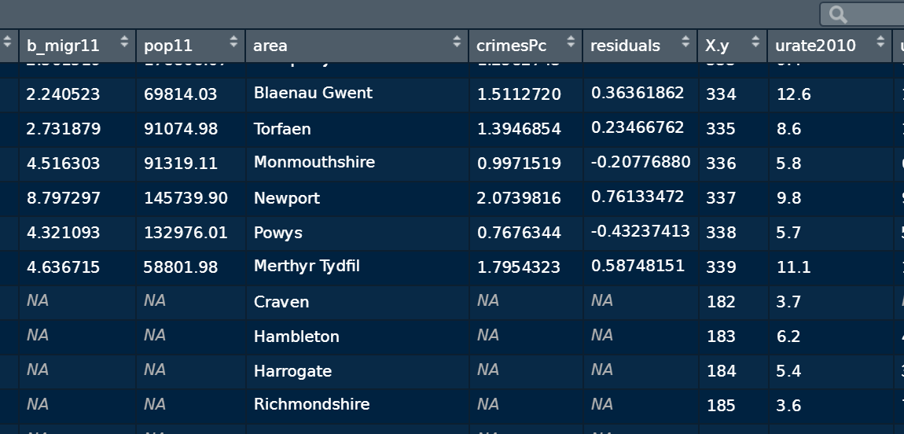
MeRrrrrging
Full join

Slide 25
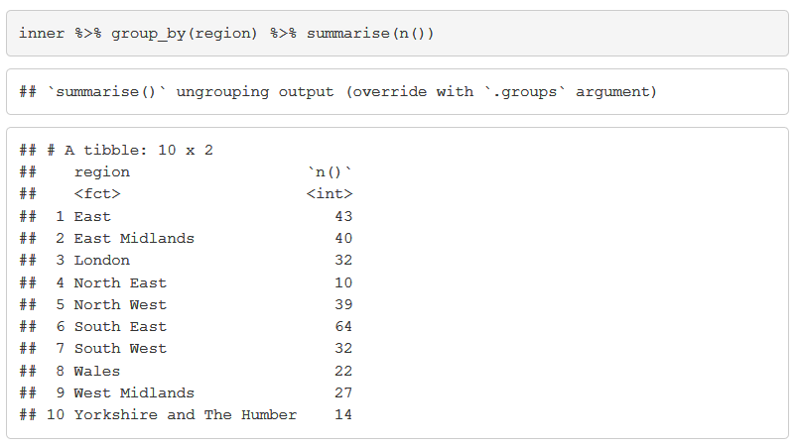
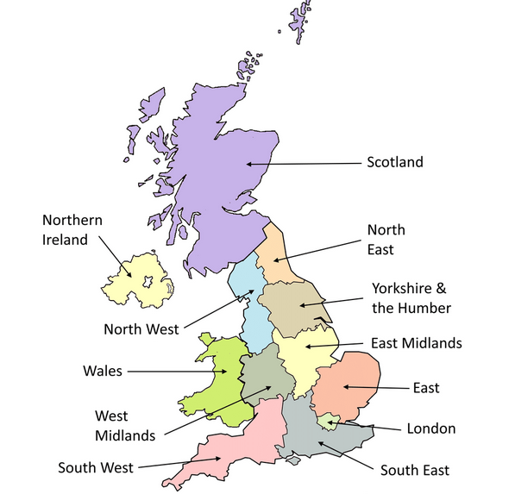
Functions
Are you starting to like R commands?
Turns out you can easily create your own
For instance: Suppose you want to re-create the earlier scatter plot for the different regions of the UK/England

Slide 26
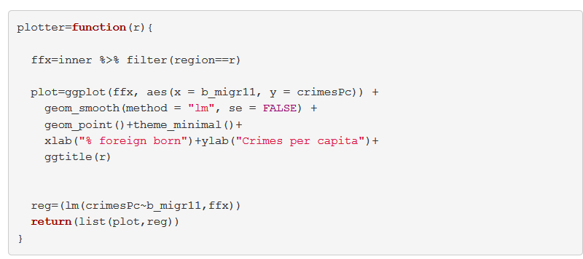
Defining a function
Global variable
Local variable
What the function returns
Here it is a list but it can be anything really

Slide 27

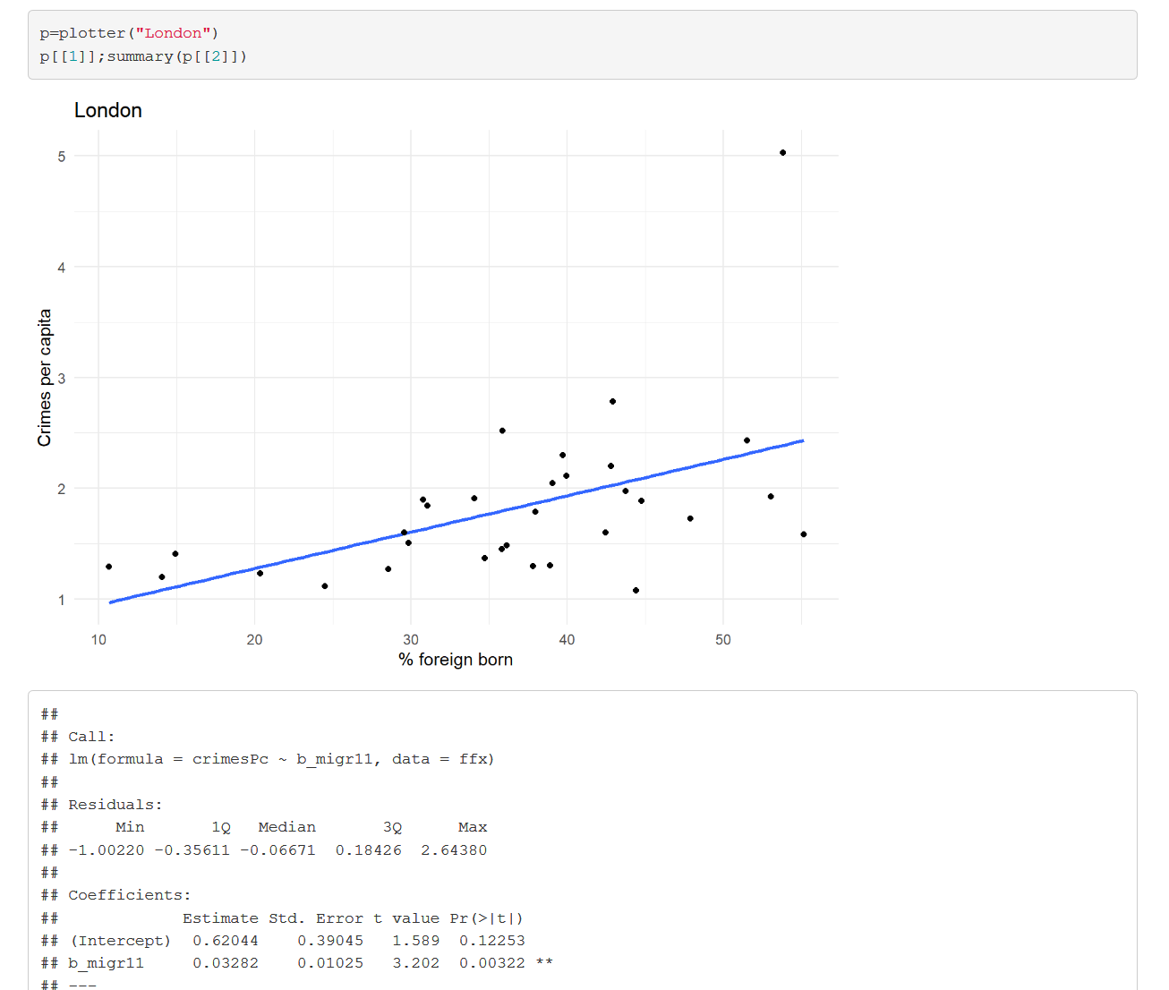
Calling functions
Function call
Display results

Slide 28

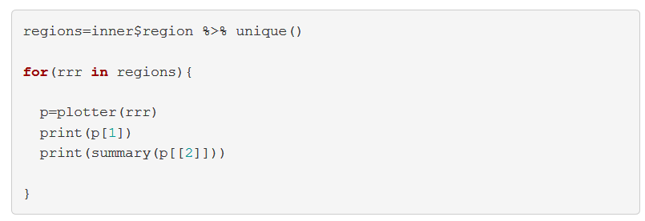
Loops

Slide 29
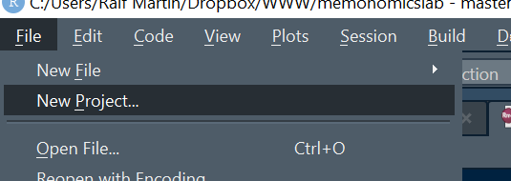
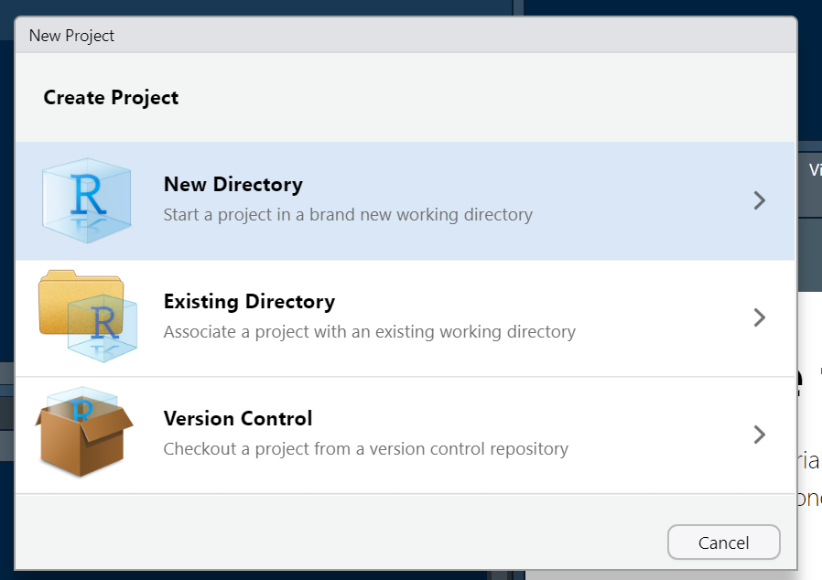
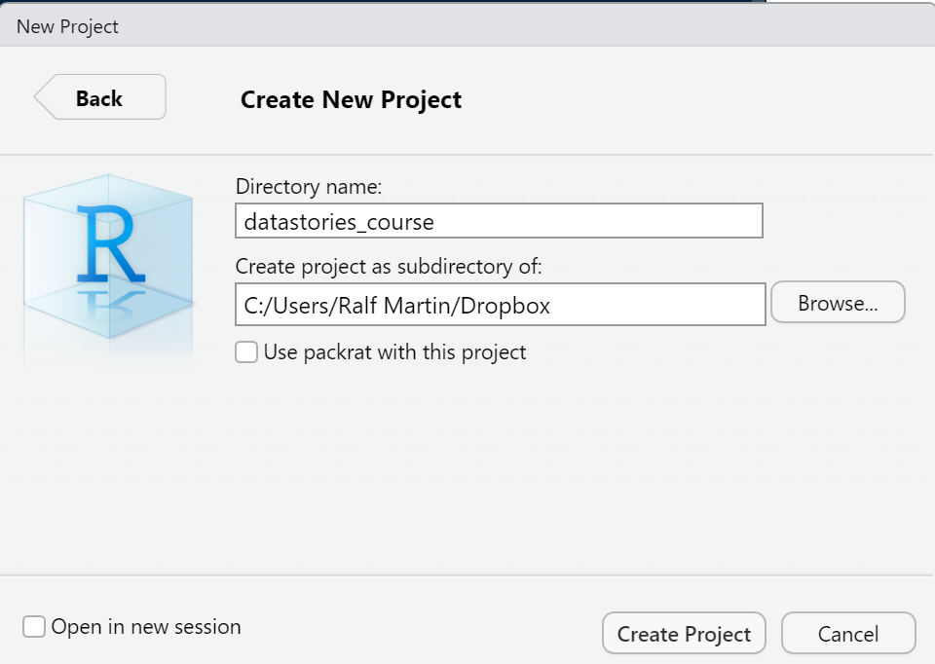
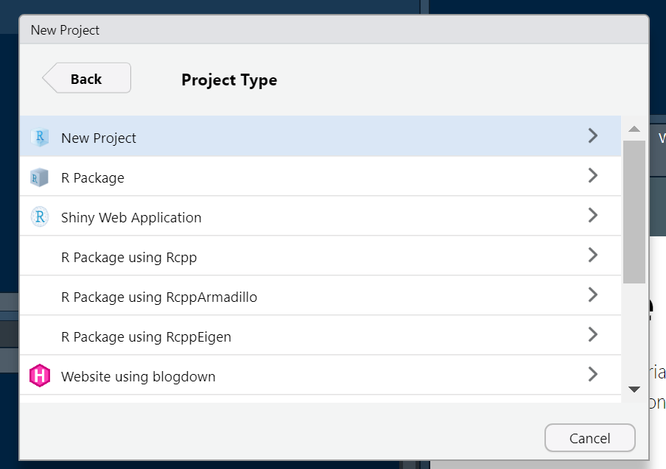
Projects and Folders
An additional tool to organise a research project are project files and dedicated folders
You can do both via the “New Project” menu:
You might want to create one for the course and one for dedicated one for the group project which you can share with your team/group (via dropbox or github)

